Slide 1
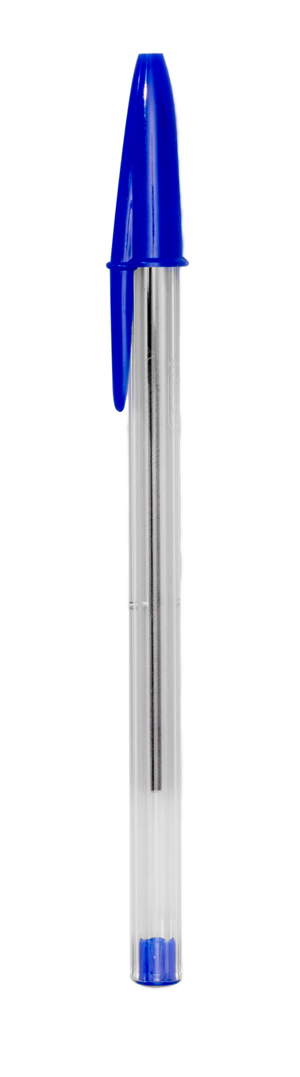
SARALSIKSHA
शिक्षा का मंत्र, सरल और सशक्त।
HARDIK KASHYAP
AAYUSH TRIPATHI
KARTIKEY PANDEY
UDIT PRATAP SINGH

Slide 2
WHOA!
According to UDISE+ 2021-22 Data, there are 102,2386 government schools and 82,480 government-aided schools in India, which make up the majority of schools
Notes:
Big text and subtitle. You can add graphic resources to the composition (photo or vector)

Slide 3
TABLE OF CONTENTS
01
02
03
04
05
06
Introduction
overview
Project Goals
You can describe the topic of the section here
You can describe the topic of the section here
You can describe the topic of the section here
Key features
Methodology
Demo
You can describe the topic of the section here
You can describe the topic of the section here
You can describe the topic of the section here

Slide 4
01
INTRODUCTION
Notes:
Title and subtitle

Slide 5
Introduction
Imagine a school where teachers spend less time battling paperwork and more time igniting young minds.
Imagine administrators navigating operations with clarity and efficiency, empowered by real-time data. Imagine parents feeling connected and informed, with their fingertips on their child's educational journey. This isn't a dream, it's the vision driving our exciting project
Notes:
Title and bullet point text

Slide 6
02
Project Overview
You can enter a subtitle here if you need it

Slide 7

Overview
we aim to transform the way education is imparted in Government schools.through our innovative digital solution and strategic interventions we have plans to change the entire learning experience and management of Government schools.
The basis of our project is integrating technology to streamline administrative processes.
This will reduce the burden of paperwork on teaching staff.
It will establish a centralized digital system for optimizing resource allocation, including allowances, scholarships, and managing government schemes like mid-day meals and vaccination programs.

Slide 8
03
Project Goals
Notes:
Title and subtitle

Slide 9

Goals
Our primary goals include:
Simplifying administrative tasks such as attendance tracking, academic record management, and communication.
Empowering teachers with tools for better classroom management and student engagement.
Providing parents with real-time updates on their child's academic progress and school activities.

Slide 10
KEY FEATURES
Student Attendance Tracking: Effortlessly monitor student attendance records in real-time.
Teacher Dashboard: Empower teachers with tools for lesson planning, grading, and communication.
Academic Record Management: Centralize student academic records for easy access and analysis.
Resource Optimization: Streamline resource allocation, including allowances, scholarships, and government scheme management.
Notes:
Title and bullet point text

Slide 11
05
Methodology
Notes:
Title and subtitle

Slide 12
Methodology
Notes:
Title and bullet point text

Slide 13
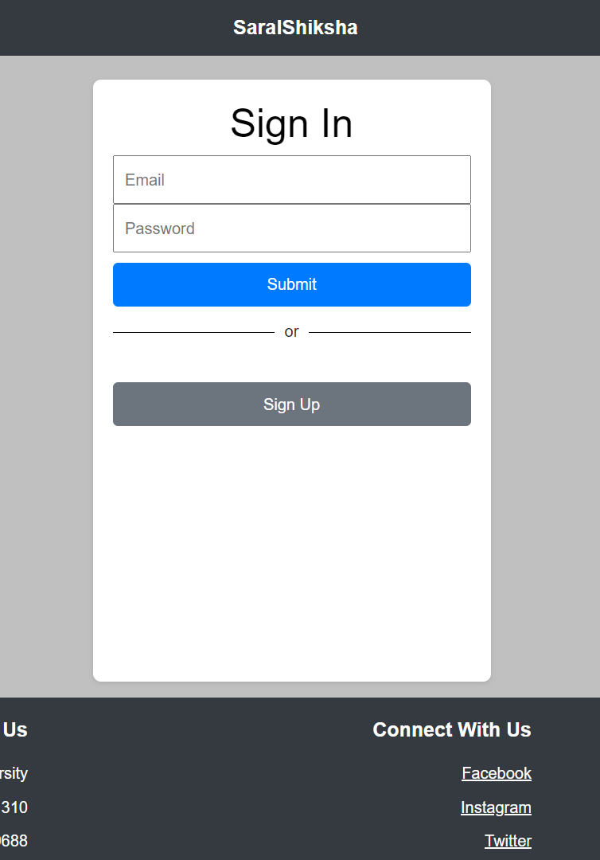
WEB APP
We also have an web app of our project.

Slide 14
THANKS
Notes:
Title and subtitle

